Slide 1


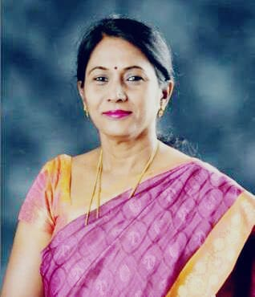
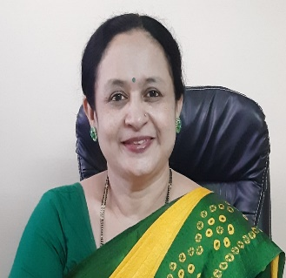
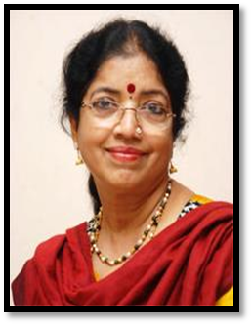
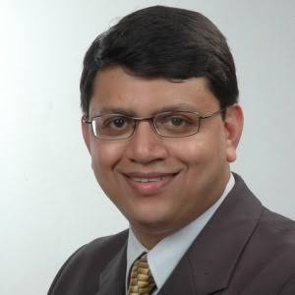
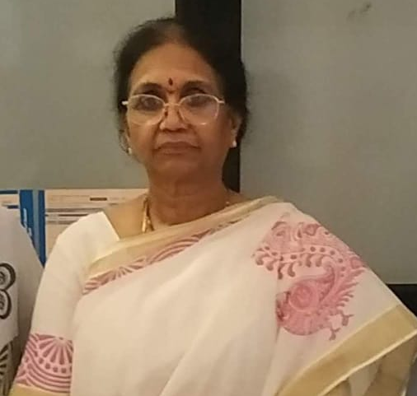
BANGALORE SOCIETY OF OBSTETRICS AND GYNAECOLOGY
Invites you for a Symposoium on
Vaccination in women & Influenza in Pregnancy
Date: 16th March 2021, Tuesday |Time: 5:00 pm To 6.30 pm
Dr Thejavathy G V
President, BSOG
Dr Rekha Rajendra Kumar
Secretary BSOG
Time | Topic | Speakers
5.00 – 5.05pm | Welcome | Dr. Thejavathy G V
5.05 – 5.35 pm | Symposium | Chairpersons: Dr. Umadevi K Dr. Rekha Rajendrakumar
5.05 – 5.35 pm | Immunization in Women – Dr. Jyothika A Desai
5.35 – 6.05 pm | Influenza in Pregnancy – Dr. Arnab Basak
6.05 – 6.20 pm | Interaction
6.20 – 6.25 pm | Closing Remarks | ABBOTT
6.25 – 6.30 pm | Vote of Thanks | Dr. Shubha Rama Rao
Chairpersons
Speakers
Dr. Jyothika Desai Dr. Arnab Basak
Dr. Umadevi K Dr. Rekha Rajendrakumar
Educational Partner: ABBOTT INDIA

